Slide 1


Sofia air pollution case
TEAM

Slide 2







Kiril
Denis
Extra fresh
Veronica
Kiwi team
Ivo
Maria

Slide 3

I. Business understanding
II. Data mining
VI. Predictive modeling
VII. Data visualization
III. Data cleaning
IV. Data exploration
V. Feature engineering
Data science life cycle
FInished

Slide 4

Business understanding
The fast-paced modern lifestyle has dramatic effect on the quality of life. Bulgaria is an example of a developing country that is not yet self-sustainable. Due to a variety of factors there are frequent cases of air pollution.
Open areas often experience more winds and are therefore more likely to have better air quality. The issue that Sofia does not have this advantage is emphasized by the lifestyle of its citizens, that does further damage. Some of the main problems are older vehicles and the use of non-ecological types of heating. Our goal is to build a successful prediction model on the expected air pollution to be measured within 24 hours.

Slide 5

II. Data mining
Our data research encompasses the first two stages of data modelling. It analyses four types of data:
The official air quality measurements are composed by five stations in the capital of Sofia;
Citizen air quality measurements that include parameters such as temperature, humidity, pressure and topography.
Meteorological measurements – one station for temperature, humidity, wind speed, pressure, rainfall, visibility;
Topography data;
The indicators from these components are important to our research as they have a correlational impact. Windy weather causes pollution to be dispersed whilst still weather allows pollution to build up.

Slide 6
III. Data cleaning
Check a sample of our measurements and create a summary for all important statistic metrics for 2017 and 2018;
Focus on the classes of the variables. ‘Time’ is not in an appropriate class;
Find and remove data for stations only observed in 2017 - in our case 11 stations;
Check for ‘NA’ and clean 4 missing geohashes. Our data set contains 1253 unique stations;
Summarize the data by creating new dataframe with significant features as unique geohashes, number of available observations, information about first time observation and difference in days between the first and last observation time;

Slide 7
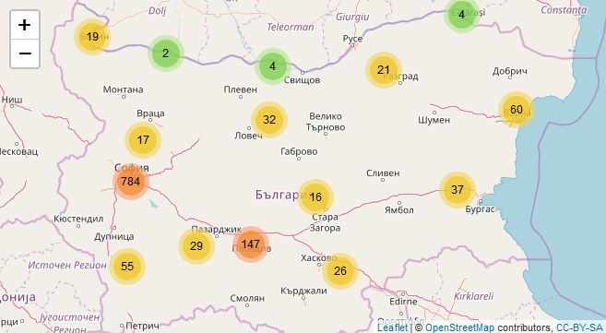
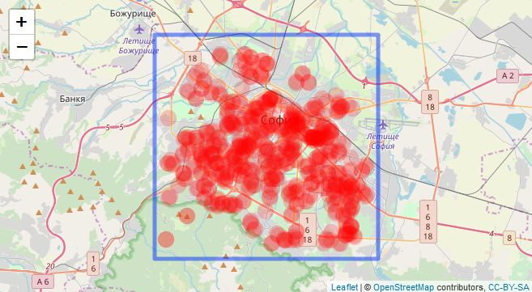
IV. Data exploration
It is time to summarize the stations on the map. We use leaflet library and add cluster condition so our observations could be grouped by region.
Observations are not concentrated only in Sofia. Our case solution is directed to predict air pollution in Sofia, so we need to filter only observations in our capital and here is the result.

Slide 8
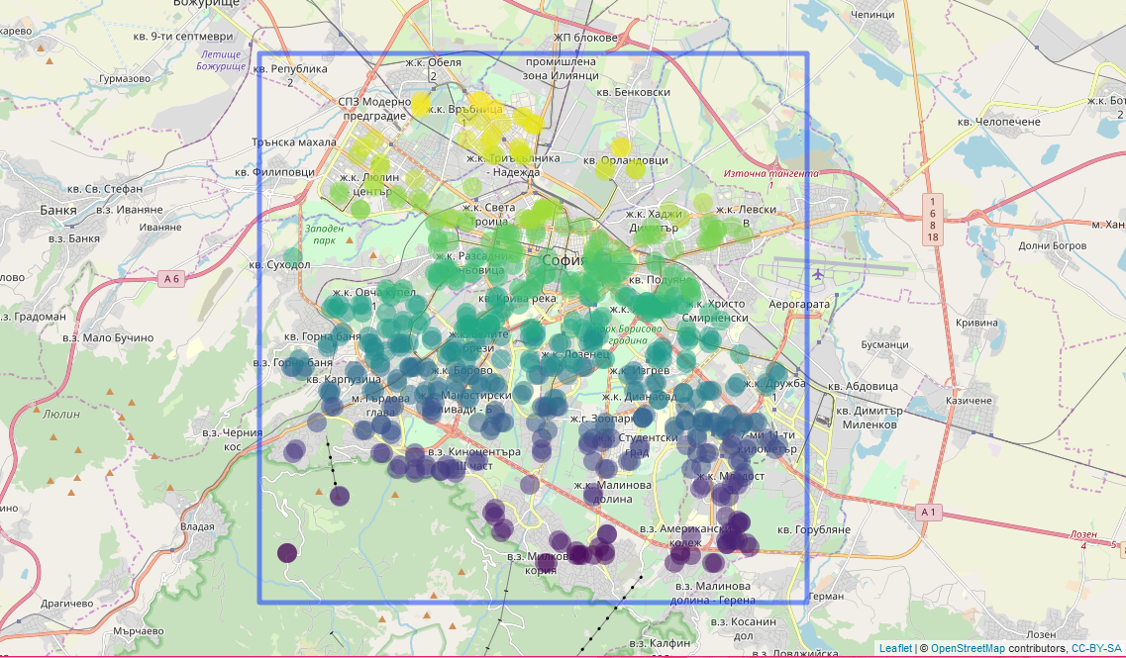
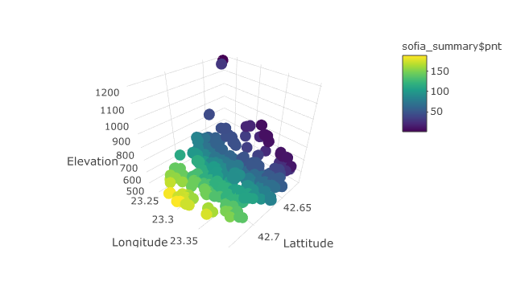
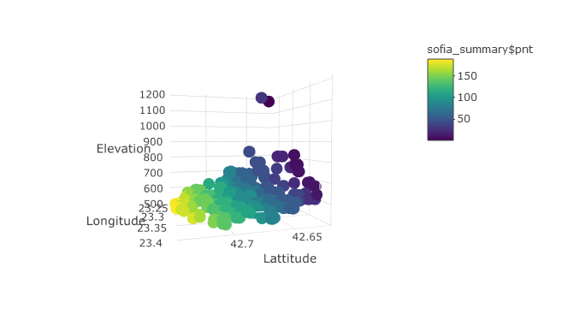
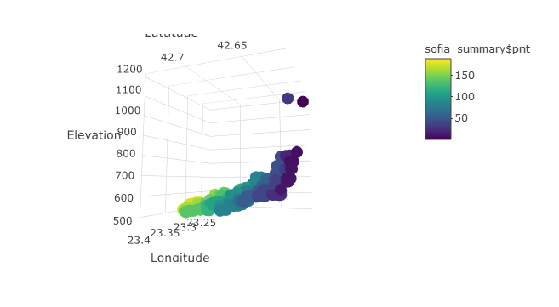
V. Feature engineering
The goal: make a final list of geo – units. Our predictive model will be based on them;
New consolidation contains 116 clusters, elevation, observations, minimum and maximum temperature, pressure and humidity values;
We restrain ourselves in the period November 2017 – August 2018 – that is the period for which we have official data;

Slide 9
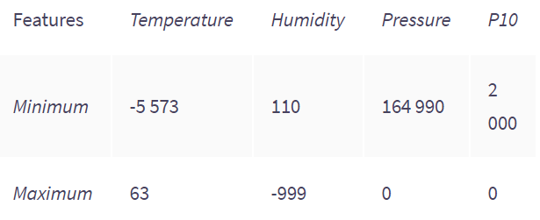
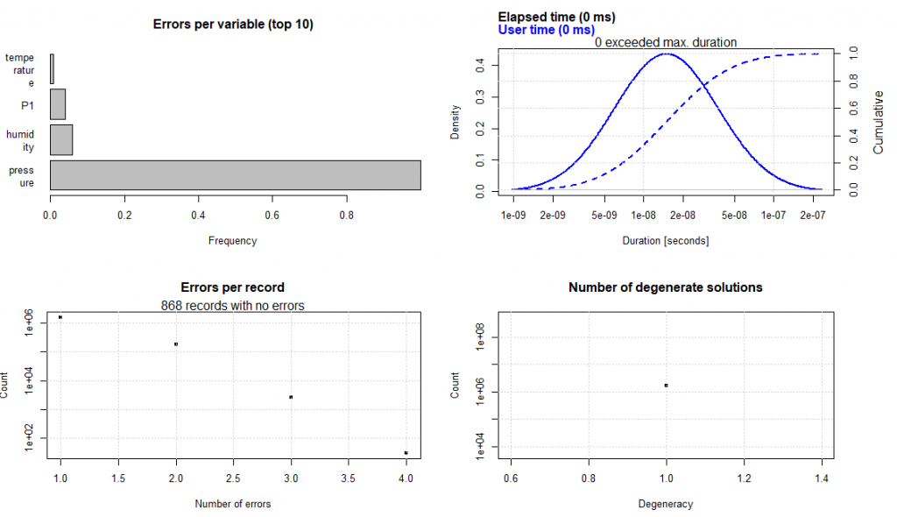
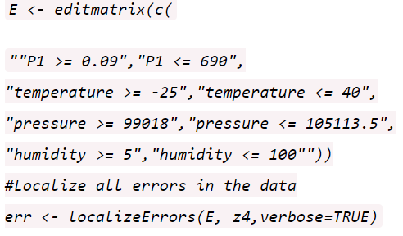
V. Feature engineering
Clear the values by using our own rules – editrules and deducorrect;
First, check for inconsistencies:
Most errors come from pressure, there are over 90% mismeasurements.
Next, we use matrix with restrictions:
Most errors come from pressure, there are over 90% mismeasurements, so filter clusters that contain most errors and we end up using 113 geo units that we create time series for.

Slide 10
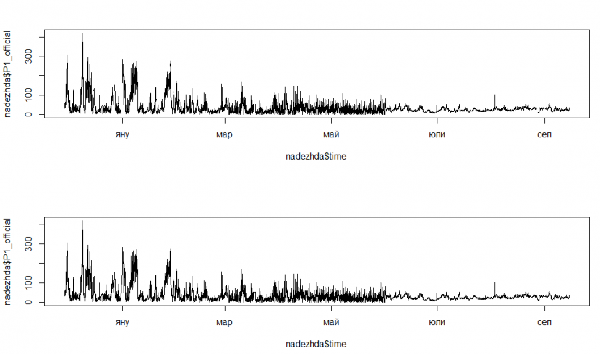
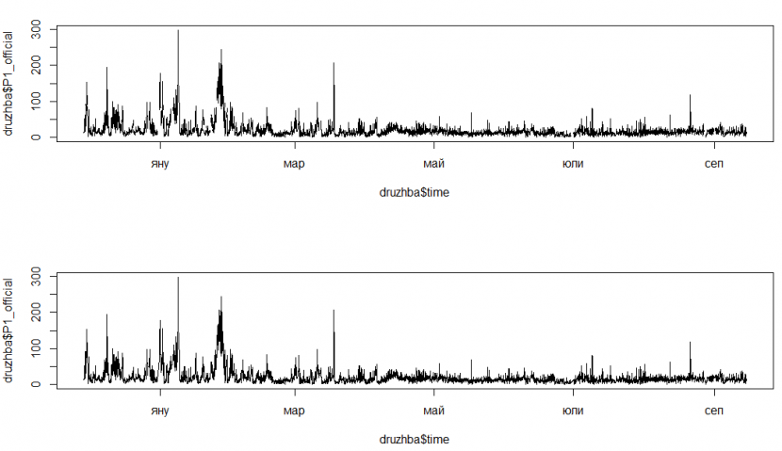
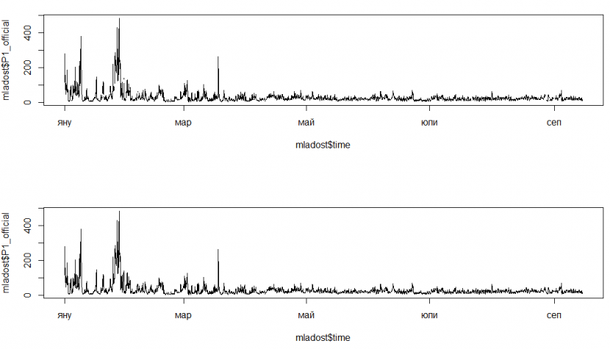
V. Feature engineering
We inspect official stations. Our list contains five stations: Nadezhda, Mladost, Pavlovo, Druzhba and Hipodruma. There are some missing values in a different months;
We interpolate missing data using linear interpolation;

Slide 11
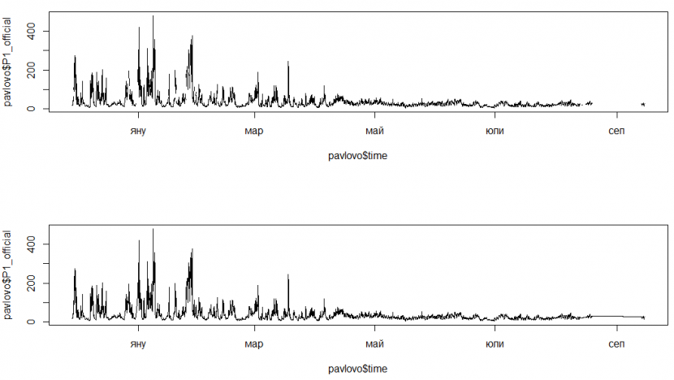
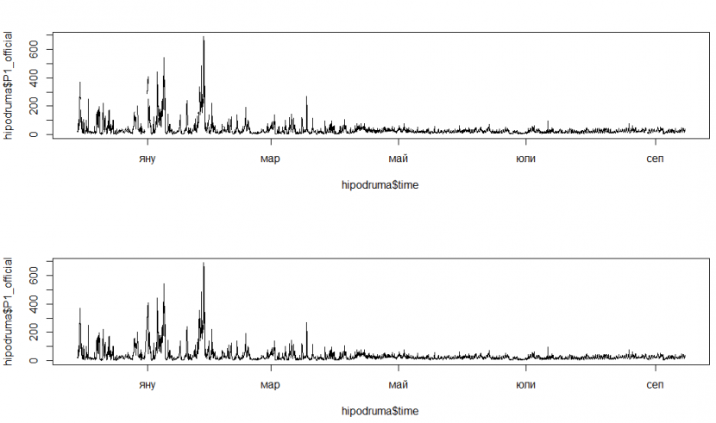
V. Feature engineering
There are significant gaps for Pavlovo station in January, February and almost throughout the whole September that need to be fixed using linear interpolation.
We create time series for every official station by hourly basis and all missing values here we interpolate using linear interpolation.
Next, we include meteorological data for 2017 and 2018 only. Observations in meteorological data set start on 2017-01-01 and end on 2018-09-17, so we have data for the whole period. We address the issue that it is per day, not hour, and we are going to deal with it in our next steps. Good thing here is that there is no NAs, so there is no interpolation needed.

Slide 12
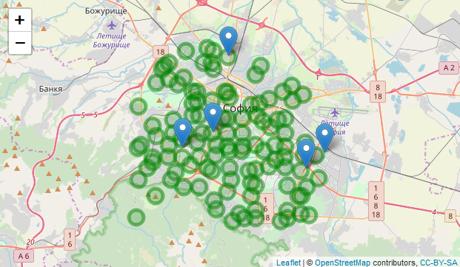
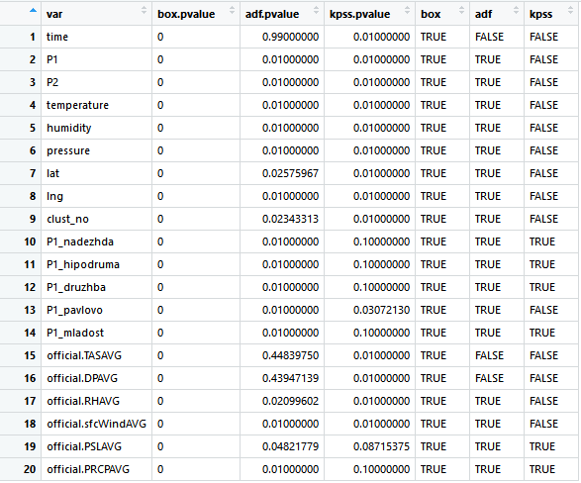
V. Feature engineering
Our next step is to plot official stations next to our geo units:
Next, we perform exploratory analysis on the statistical characteristics of the response variable for each geo-unit.
It can be noted that the official stations are not evenly distributed on the territory of Sofia and therefore can not be used for clusters center.

Slide 13
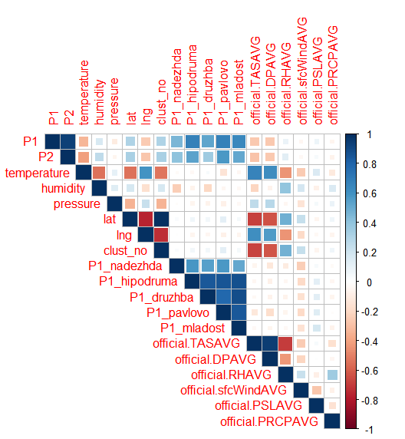
V. Feature engineering
Create time series by day and fix some classes for year, month and day, check for NAs. There are no NAs, so no interpolation will be needed
We address some issue on a daily basis and we are going to deal with it in our next steps
Observations in meteorological data set start on 2017-01-01 and end on 2018-09-17, so we have data for the whole period
Make a correlation plot

Slide 14
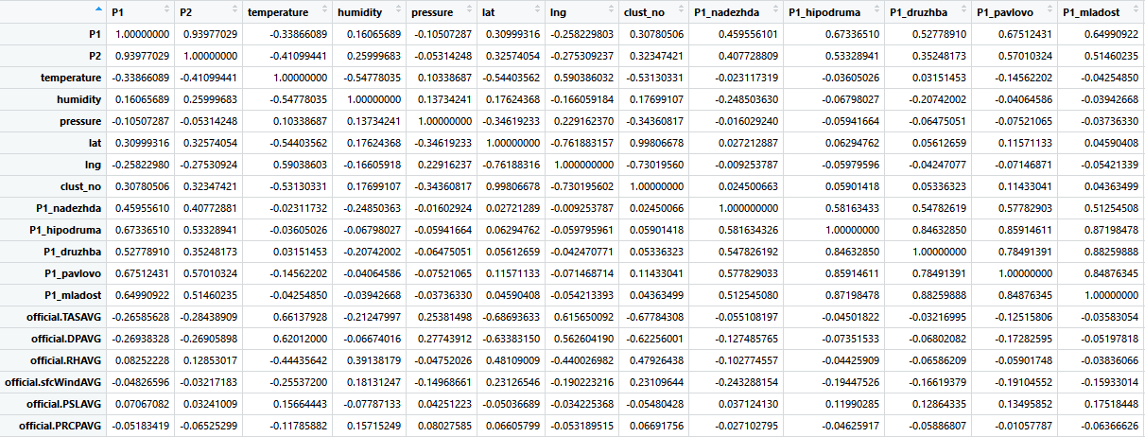
VI. Predictive modeling
NA threshold treatment: we're going to delete all geo units, for which we have more than 20% missing values.
We end up with 75 clusters, 38 were removed, since the P1 variable has more than 20% missing values.
Next, we use linear method for interpolation of missing observations.
Now that we have our list, we check the correlation between response variable and the rest with correlation_threshold<-0.75
There are 3 clusters that have no correlation of the response variable and the rest of the variables above the correlation_threshold and we remove them to have the final cluster list of 72 clusters. They have coverage across the city.

Slide 15
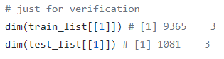
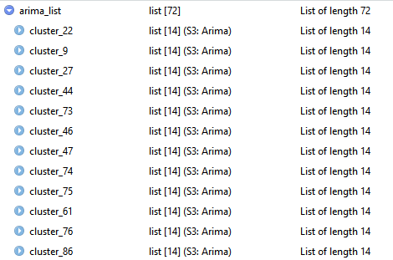
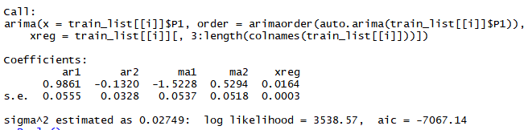
VI. Predictive modeling
We divide our set into training and test
For testing purposes, we define all values after 1st August 2018
Next, we create ARIMA model for each one of our 72 clusters:
These are the results for first cluster:

Slide 16
VII. ACCURACY OF THE MODELS
Validation of our results ->
Code:
Build a predictive model for the chance of exceedance of 50 µg/m3 average for the day adjusted PM10 concentration at every geo-unit
results <- list()
for (i in 1:length(test_list)){
results[[i]] <- predict(arima_list[[i]], newxreg = test_list[[i]][,3:length(colnames(test_list[[i]]))])
}
comparison <- list()
for (i in 1:length(test_list)){
comparison[[i]] <- as.numeric(mean(results[[i]][[1]])) / as.numeric(lapply(test_list[[i]]["P1"], mean)) * 100
}
z <- as.data.frame(unlist(comparison))
z$cluster <- names(arima_list)

Slide 17
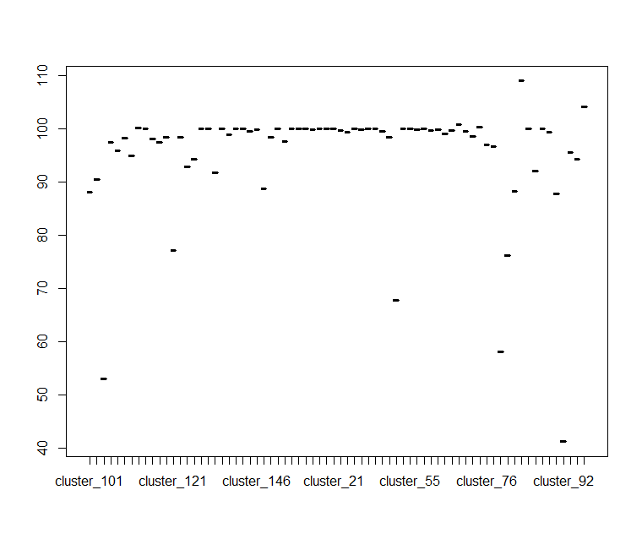
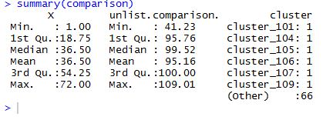
Prediction comparison

Slide 18
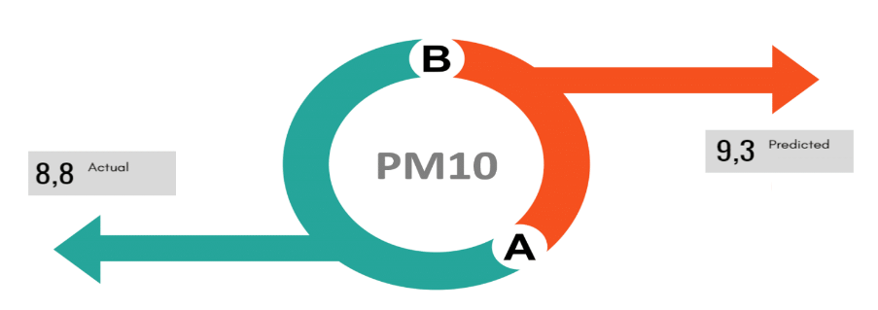
Prediction validation
*Validation is against the test dataset (24 hours of measurements for 13 of September, 2019)

Slide 19
Datathon article (:
Click here to try our code
Kiril
Denis
Thank you!
Veronica
Kiwi team
Ivo
Maria

